Slide 1

01
Using 'Event Check-in' For Attendance
How to collect event attendance while maintaining social distance

Slide 2



Download the App:
Campus Labs'Event Check-In'
SOURCE: CAMPUS LABS

Slide 3
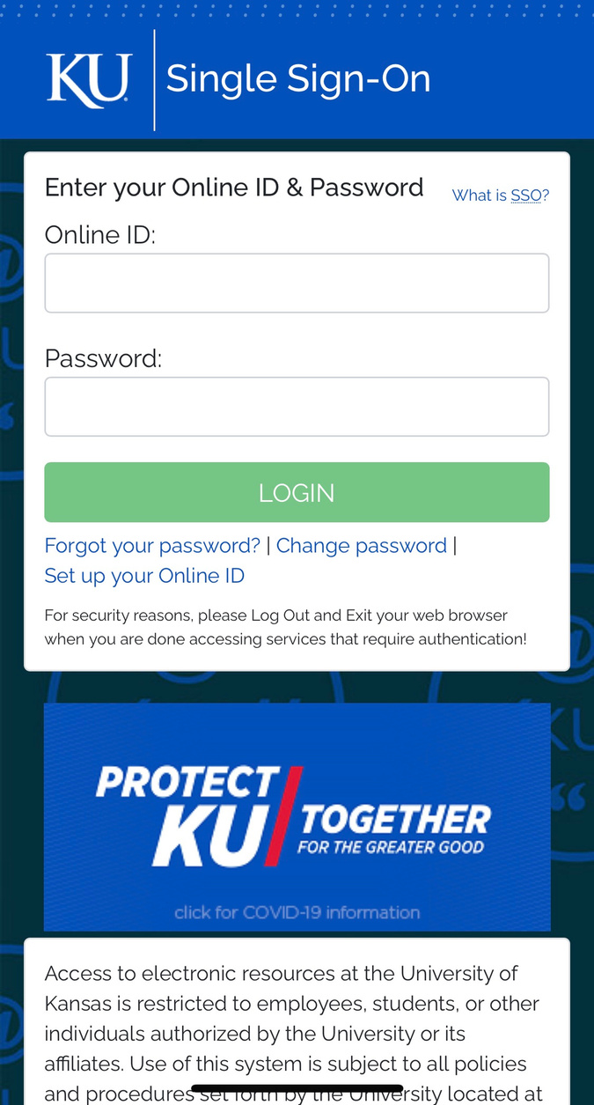
Open the App & Sign In!
  Use your KU alphanumeric online ID, just like when logging into Rock Chalk Central on your phone or computer

Slide 4
Get the Event's 'Access Code' from the Volunteer Check-In Document and input it.

Slide 5
Make sure you gave the app permission to use the camera so you can scan students' Event Pass QR codes
Now that you're all set...
Ask student's attending your event to provide their Event Pass for you to scan & hit accept once it's detected who that person is
As a pro tip: if a student has yet to download their Event Pass or can't login the CORQ app & RCC website, they can provide you with their alphanumeric ID and you'll be able to check them in manually

