Slide 1
Have you checked into Jayhawks Give a Flock via the Corq app?

Slide 2


DEVELOPED BY THE SEXUAL ASSAULT PREVENTION & EDUCATION CENTER
JAYHAWKS GIVE A FLOCK!
BYSTANDER INTERVENTION WORKSHOP
FOR THE UNIVERSITY OF KANSAS
Updated Version Spring 2023
1
Notes:
Timestamp: 0:00-2:00 minutes
Slide 1 is the introductory slide. Display it on the screen when participants arrive and keep the slide up while introductions are being made.
Introduce yourself and outline what you will cover in the 90minute program:
Introduce the bystander model.
Apply the bystander model to sexual violence.
Develop skills as a bystander.

Slide 3





LEARNING OUTCOMES
Students will RECOGNIZE sexual violence as a serious campus issue.
Student will IDENTIFY barriers and develop a plan for safe bystander intervention.
Students will understand how to FOLLOW UP by supporting survivors and holding offenders accountable.
Student will apply strategies to INTERVENE (Delegate, Distract, Direct) as a group.
Learning outcomes based on It’s On Us campaign: http://www.itsonus.org//
2
Notes:
Timestamp: 2:00-4:00 minutes
The goal of this slide is to provide an overview of the program and let them know what we will be discussing. The learning outcomes also mirror the four-step model of bystander intervention that will be used throughout this workshop.

Slide 4
A FEW DISCLAIMERS.
Jayhawks Give a Flock uses situations and topics that can be difficult for some students affected by sexual violence. If you are unable to participate, confidential advocates are on site for any students who would like to talk to someone and hold space for their feelings.
Most incidents of sexual violence feature women as survivors and men as offenders. However, it is important to note sexual violence is experienced by people of all gender identities and sexual orientations.
Students are encouraged to share their experiences as bystanders. That stated, almost all of our facilitators are mandatory reporters to the University, meaning they have an obligation to report instances of sexual violence to the Office of Civil Rights & Title IX.
Campus and community resources for survivors will be provided at the end of the workshop.
3
Notes:
Timestamp: 4:00-7:00 minutes
The goal of this slide is to provide some disclaimers and content (trigger) warnings for this material. Participants should be reminded that if they are unable to complete the training due to the content, they can arrange alternative training through the CARE Coordinator. Additionally, participants should be reminded that almost all of our facilitators are mandatory reporters to the University. Meaning, that if a student discloses that they have experienced sexual violence and the offender is a student, faculty, or staff, the facilitator most report any information shared with the Office of Civil Rights & Title IX. Based on the information shared, an investigator from OCR will reach out to that student and invite the student to have a conversation with the investigator. Please note: the student is in control of the University process. They choose who to talk to, what information to share, decide what resources to use, determine if they want to file a complaint, can stop the process at any time, and choose if they want to go to law enforcement. More information can be found by visiting https://civilrights.ku.edu/.

Slide 5
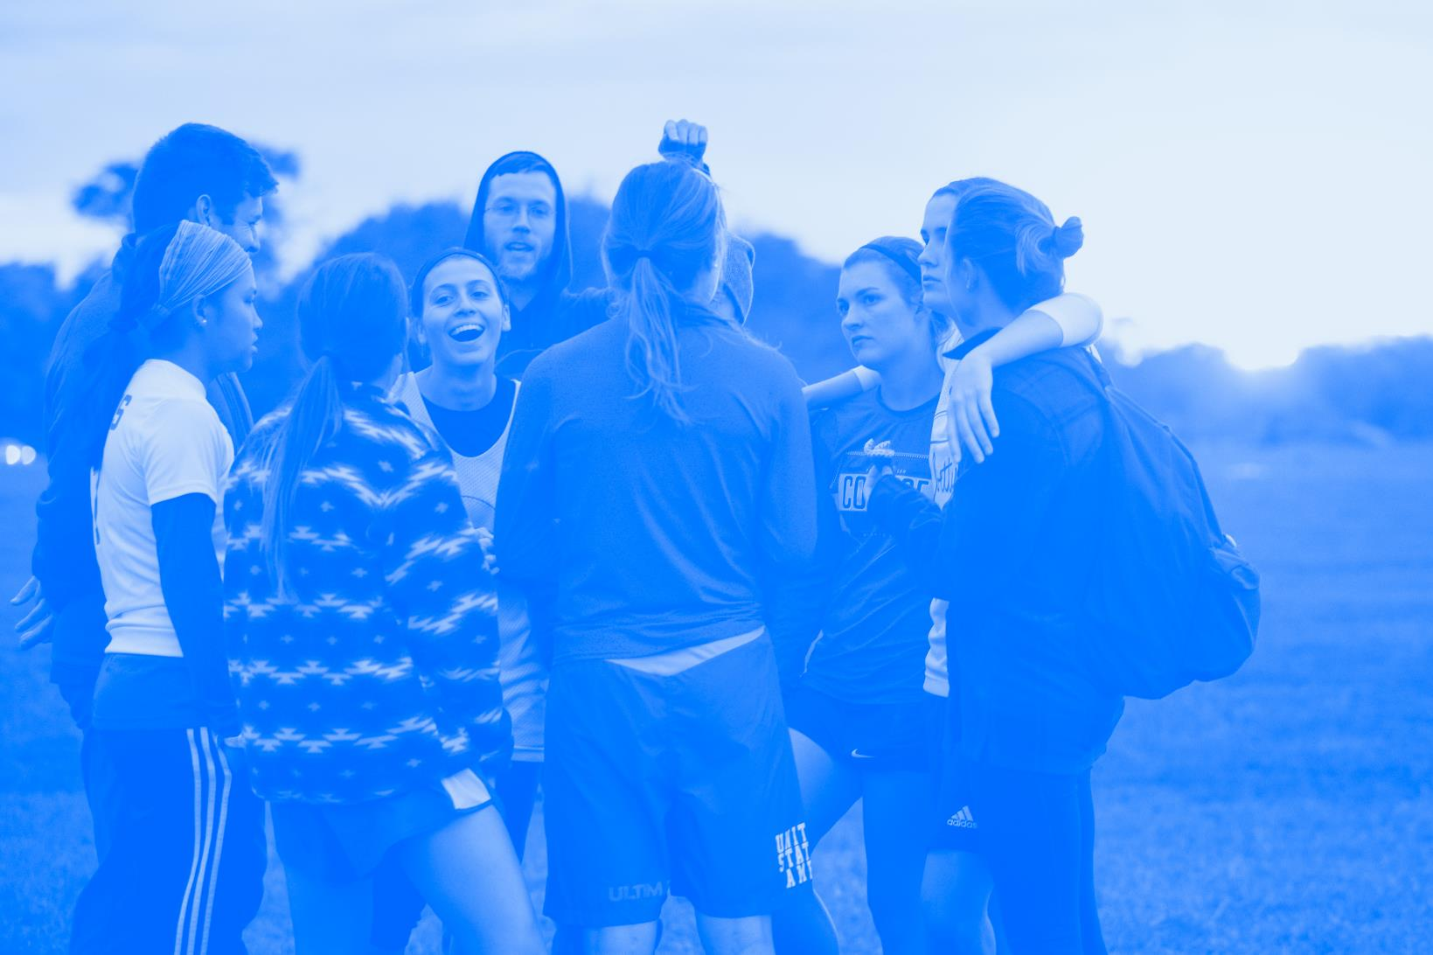
LET’S SET A Group Agreement
4
Notes:
Timestamp: 7:00-8:30 minutes
Have the participants establish a group agreement for the session.
You may consider saying something to the effect of:
Given the challenging nature of what we are going to discuss
in this workshop it is important that all participants feel this is
a space where they feel able to express their thoughts and
feelings. What are some group agreements you have used before or heard that would be helpful for this workshop?
Be sure to ask clarifying questions if an agreement offered in unclear. For example, you can say
“can you say more about that?” or “what does (insert group agreement) mean in your words?” Once the participants have identified 3-5 ground rules, you may move on to the next slide.

Slide 6
GROUP AGREEMENT
CHALLENGE YOURSELF
SELF-CARE
RESPECT
5
Notes:
Timestamp: 8:30-14:00 minutes
After soliciting suggestions from participants, review the following group agreement. Ideally, many of these will have been covered by the participants. If not, be sure to discuss any ground rules that not yet been discussed.
Challenge yourself
It’s normal to feel some discomfort when talking about a topic that we don’t discuss as much as other topics. Try your best to lean into that feeling and explore why you might feel uncomfortable.
Be aware of your identities and how those have impacted your experiences, as well as how you communicate in this space. For example, we know that people with some privileged identities tend to speak more often or interrupt others.
If you are someone who comments a lot in group discussions, challenge yourself to listen more today.
If you are someone who doesn’t comment very much in large-group discussions, challenge yourself to participate beyond your comfort
Self care
It’s important to take care of yourself throughout this training as well as afterwards, so if you feel that you need to leave the room and take a break, please don’t hesitate. If you leave the room and are gone for a while, a facilitator may come to check up on you to make sure you are okay.
It is likely that there are primary or secondary survivors in the room because this problem is so prevalent- take care of yourself.
Respect
If you hear something problematic or disrespectful, we hope you will challenge that comment or idea in a respectful way.
Keep interruptions, cell phone use, and side conversations to a minimum out of respect for the presenters or whoever is speaking.
Although this is a serious topic, we do want to make this enjoyable to you by engaging in activities. Please note that we may laugh when an activity is funny, but we are not ever laughing at the situation or at violence.
It’s important to assume best intentions in discussions like this one. Everyone here wants to learn more and is interested in preventing violence. If someone makes a comment that upsets you, approach them as an ally whom you can help to learn something new.
In addition, facilitators should announce that they will stay for a few minutes after the program to answer any questions or talk about anything that may have come up during the program, offering resources etc., to participants.
[Similarly—if it applies—facilitators should announce that they have experience working with survivors/secondary survivors and that they are happy to talk to anyone afterwards that may be interested. If an advocate from a local crisis center is present let participants know the advocate is also available to talk to anyone.]

Slide 7
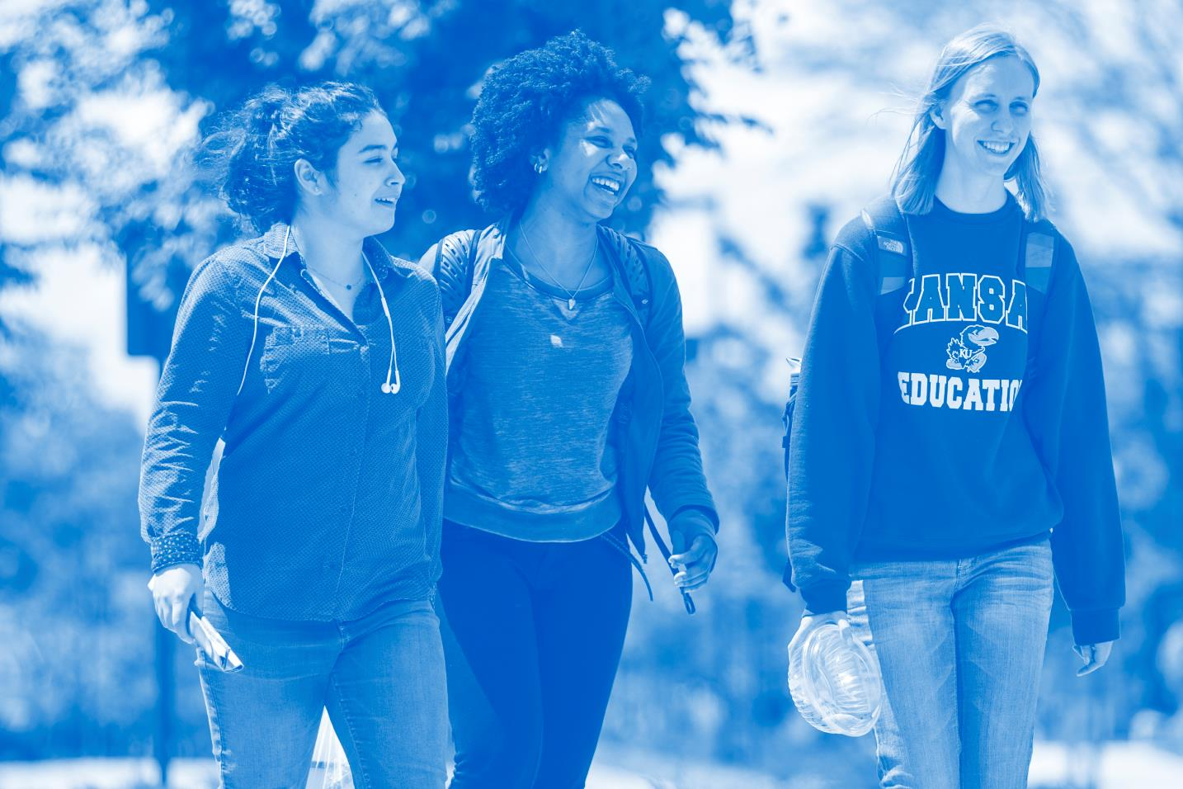
WHAT IS A BYSTANDER?
6
Notes:
Timestamp: 14:00-17:00 minutes
Begin with group brainstorm.
What is a bystander? Do we think of a bystander in positive or negative terms?
Why do you think that is?
Once you have sufficient answers from participants, it is time to move onto the next slide.

Slide 8
Individuals who witness concerning behaviors, problematic events, or emergencies and by their presence have the opportunity to provide assistance, do nothing, or help facilitate the negative behavior.
In the context of this workshop, the term active bystander will be used to refer to an individual who intervenes in a way that impacts the outcome positively.
Being an active bystander means assessing how we can best support the person experiencing harm, while also limiting any additional harm from occurring in the process.
by·stand·er
/ˈbīˌstandər/
(noun):
Bystander: Sotieria Solutions
7
Notes:
Timestamp: 17:00-20:00 minutes
Read the definitions and discuss the shared components of the participants’ definition and the research definitions on the slide. Emphasize the participants’ strengths and existing knowledge by pointing out that they already got much of the definition.
Explain the goals of this program are to 1.) challenge the current understanding about what it means to be a bystander and 2.) encourage people to become active, prosocial bystander.

Slide 9

WHEN HAVE YOU BEEN AN
ACTIVE BYSTANDER?
8
Notes:
Timestamp: 20:00-24:00 minutes
The goal of this slide is to provide participants with an opportunity to be an active bystander in the past. Facilitators may choose to share a time when they have been an active bystander in the past as an example. Please identify an “everyday type” of example. We want to normalize that being a bystander does not have to be heroic, it can be a built in part of how we show up for people on a day-to-day basis.
Explain that although we are here to learn how to become better active bystanders we know that many of our students have already demonstrated this in the past. For the participants that do share, feel free to ask follow up questions about the incident, what compelled them to intervene, what they had to consider, and why they chose the strategy they took.

Slide 10
WHY SHOULD JAYHAWKS GIVE A FLOCK?
JAYHAWK VALUES
As Jayhawks, we are committed to a set of core values:
We will actively foster UNITY. A community based in tradition and continually growing through healthy relationships and effective communication.
We will strive for INNOVATION, using our education to find new and creative solutions to the problems facing our campus, our community, and the world.
We will advocate for INCLUSION, respecting all Jayhawks are unique and have their own personal stories while cultivating a safe community rooted in equity and justice.
We will value ENGAGEMENT, taking responsibility inside and outside of the classroom to be active members of the global community.
Jayhawk Values: https://studentaffairs.ku.edu/values
9
Notes:
Timestamp: 24:00-25:00 minutes
The goal of this slide is to inform the participants that the goals of this program are consistent with the expected standard of behavior at KU as outlined in the Code of Student Rights and Responsibilities.
As Jayhawks, student should “give a flock” or care about their community because it is aligned with the four Core Values (respect, community, integrity, and responsibility) that were developed by their fellow students and included in The Code.

Slide 11
STEP ONE: RECOGNIZE that something is happening or has happened
10
Notes:
Timestamp: 25:00-25:30 minutes
As mentioned, the first step to reducing and preventing sexual violence is to understand the issue and how it affects members of our Jayhawk community. In this section we will define sexual violence, review facts surrounding the issue, and recognize the attitudes and behaviors that negatively influence rates of sexual victimization.

Slide 12
RECOGNIZING SEXUAL VIOLENCE
SEXUAL VIOLENCE:
any sexual act that is imposed on another person without their consent and is perpetrated through use of incapacitation, deception, coercion, fear, or force.
11
Notes:
Timestamp: 25:30-28:00 minutes
The goal of this slide is to provide participants with a basic understanding of what constitutes sexual violence. To understand the difference between sexual assault and sexual violence, read/review interchanging the terms sexual assault and sexual violence.
Sexual Violence is:
Any sexual act that that is imposed on another person without their consent and is perpetrated through the use of deception, coercion, fear, or force.
An act of power and control, not sex.
Includes but is not limited to rape, sexual assault, sexual battery, and sexual exploitation
Can be experienced by people regardless of sex, sexual orientation, gender expression, age, ability, race, ethnicity, religion, socioeconomic status, and/or national origin.
Not a result of consuming alcohol but can be used by offenders on vulnerable targets.

Slide 13

SEXUAL VIOLENCE IN OUR COMMUNITY
1 in 5 women will experience sexual violence while in college.
Source: The National Intimate Partner and Sexual Violence Survey (2018): 2015 Data Brief.
12
Notes:
Timestamp: 28:00-28:15 minutes
The goal of the statistics slides is to point out that sexual violence is experienced by people of many identities in our campus community.
The “1 in 5” statistic is often used to discuss the number of women who experience sexual violence while in college. However, this does not tell the full story about how sexual violence is experienced by people holding different identities and/or sexual orientations. These can be facilitated relatively quickly but ensure that you go through each statistic individually. Before teaching this slide, be familiar with all the facts and be comfortable expounding on each of them.
Please note: most of this data is from the National Intimate Partner and Sexual Violence Survey’s (NISVS) 2015 Summary Report. These findings were based on interviews conducted with over 16,000 adults (9.086 women and 7, 421 men). Unfortunately, this sample did not include a statistically significant sample of Asian or Pacific Islander (API) or transgender participants and, as such, those results were not included in the report. Where data was lacking, statistics were taken from other studies including the National Violence Against Women Survey from the Department of Justice and resources for supporting transgender survivors. It should also be noted that other marginalized/oppressed identities are also at higher risk of experiencing sexual violence (e.g. people with disabilities, children, the elderly, and undocumented people) as offenders will tend to target more vulnerable individuals.

Slide 14
SEXUAL VIOLENCE IN OUR COMMUNITY
7% of men will experience sexual violence while in college.
Source: The National Intimate Partner and Sexual Violence Survey (2018): 2015 Data Brief.
13
Notes:
Timestamp: 28:15-28:30 minutes

Slide 15
SEXUAL VIOLENCE IN OUR COMMUNITY
7%* of Asian/Pacific Islander women will experience sexual violence in their lifetimes.
*Likely underreported.
Source: Extent, Nature, and Consequences of Rape Victimization: Findings From the National Violence Against Women Survey from the Department of Justice.
14
Notes:
Timestamp: 28:30-28:45 minutes

Slide 16
SEXUAL VIOLENCE IN OUR COMMUNITY
14.6 % of Hispanic/Latinx women will experience sexual violence in their lifetimes.
Source: The National Intimate Partner and Sexual Violence Survey (NISVS): 2010 Summary Report.
15
Notes:
Timestamp: 28:45-29:00 minutes

Slide 17
SEXUAL VIOLENCE IN OUR COMMUNITY
18.8 % of Caucasian/White women will experience sexual violence in their lifetimes.
Source: The National Intimate Partner and Sexual Violence Survey (NISVS): 2010 Summary Report.
16
Notes:
Timestamp: 29:00-29:15 minutes

Slide 18
SEXUAL VIOLENCE IN OUR COMMUNITY
22% of African-American/Black women will experience sexual violence in their lifetimes.
Source: The National Intimate Partner and Sexual Violence Survey (NISVS): 2010 Summary Report.
17
Notes:
Timestamp: 29:15-29:30 minutes

Slide 19
SEXUAL VIOLENCE IN OUR COMMUNITY
26.9% of Native American/Alaskan Native women will experience sexual violence in their lifetimes.
Source: The National Intimate Partner and Sexual Violence Survey (NISVS): 2010 Summary Report.
18
Notes:
Timestamp: 29:30-29:45 minutes

Slide 20
SEXUAL VIOLENCE IN OUR COMMUNITY
33.5% of biracial/multiracial women will experience sexual violence in their lifetimes.
Source: The National Intimate Partner and Sexual Violence Survey (NISVS): 2010 Summary Report.
19
Notes:
Timestamp: 29:45-30:00 minutes

Slide 21
SEXUAL VIOLENCE IN OUR COMMUNITY
13% of lesbian women will experience sexual violence in their lifetimes.
Source: The NISVS: An Overview of 2010 Findings on Victimization by Sexual Orientation
20
Notes:
Timestamp: 30:00-30:15 minutes

Slide 22
SEXUAL VIOLENCE IN OUR COMMUNITY
46% of bisexual women will experience sexual violence in their lifetimes.
Source: The NISVS: An Overview of 2010 Findings on Victimization by Sexual Orientation
21
Notes:
Timestamp: 30:15-30:30 minutes

Slide 23
SEXUAL VIOLENCE IN OUR COMMUNITY
26% of gay men will experience rape, physical violence, and/or stalking by a partner in their lifetimes.
Source: The National Intimate Partner and Sexual Violence Survey (NISVS): 2010 Summary Report.
22
Notes:
Timestamp: 30:30-30:45 minutes

Slide 24
SEXUAL VIOLENCE IN OUR COMMUNITY
37% of bisexual men will experience rape, physical violence, and/or stalking by a partner in their lifetimes.
Source: The National Intimate Partner and Sexual Violence Survey (NISVS): 2010 Summary Report.
23
Notes:
Timestamp: 30:45-31:00 minutes

Slide 25
SEXUAL VIOLENCE IN OUR COMMUNITY
50% of trans folks will experience sexual violence in their lifetime.
Source: Let’s Talk about It: A Transgender Survivor’s Guide to Accessing Therapy: http://forge-forward.org/2015/05/07/lets-talk-about-it-a-transgender-survivors-guide-to-accessing-therapy/
24
Notes:
Timestamp: 31:00-34:00 minutes
Questions to pose:
What stood out to you about those statistics?
Were there any themes you noticed?

Slide 26
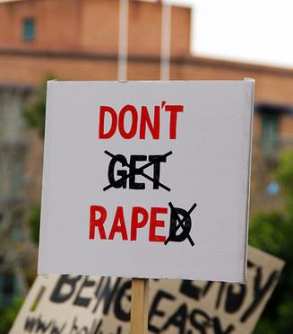
RAPE CULTURE IN SOCIETY
RAPE CULTURE:
“Rape culture includes jokes, TV, music, advertising, legal jargon, laws, words and imagery, that make violence against women and sexual coercion seem so normal that people believe that rape is inevitable. Rather than viewing the culture of rape as a problem to change, people in a rape culture think about the persistence of rape as ‘just the way things are.’”
Source: Force: Upsetting the Rape Culture: http://www.upsettingrapeculture.com/
25
Notes:
Timestamp: 34:00-37:00 minutes
Again, have a participant or facilitator read the slide.
“Rape culture includes jokes, TV, music, advertising, legal jargon, laws, words and imagery, that make violence against women and sexual coercion seem so normal that people believe that rape is inevitable. Rather than viewing the culture of rape as a problem to change, people in a rape culture think about the persistence of rape as ‘just the way things are.’”
You do not have to directly ask the following question s, but they are helpful to keep in mind when facilitating a conversation
What are some examples of being a passive bystander to rape culture?
What are some examples of facilitating rape culture?
Can you think of things that people do at KU without realizing that they may be inadvertently helping a rapist?
How are ways you can be proactive and as a result perhaps prevent an act of sexual violence taking place?
What are some examples of camouflaging?
Are there things that you may be doing or that you have observed in your community that may provide camouflage to an offender?

Slide 27
Recognizing Realities of Sexual Violence
Alcohol does not cause sexual assault. However, many offenders use alcohol as a weapon against vulnerable targets.
Almost all reports of sexual violence are true. Only 2-8% of reports are false.
Most college sexual assaults (73%) are perpetrated by an acquaintance or non-stranger.
The majority of men (94%) will never rape. However, those who do will perpetrate 5.7 times.
Most offenders are never held accountable through a formal system.
Sources: Department of Justice, Office of Justice Programs, Bureau of Justice Statistics, Felony Defendants in
Large Urban Counties, 2009 (2013) Retrieved from https://www.rainn.org/statistics/perpetrators-sexual-violence
Lisak, D. & Miller, P.M. (2002). Repeat rape and multiple offending among undetected rapists. Violence and Victims.
Lisak, D., Gardinier, L., Nicksa, S.C., & Cote, A.M. (2010). False allegations of sexual assault: An analysis of ten
years of reported cases. Violence Against Women, 16, 1318-1334. doi:10.1177/1077801210387747
26
Notes:
Timestamp: 37:00-42:00 minutes
This slide can be facilitated relatively quickly. It is sufficient to go through each fact individually. Before teaching this slide, be familiar with all of the facts and be comfortable expounding on each of them.
NOTE OF CAUTION!
Students are often confused about the relationship of alcohol to consent. They might show some resistance to the idea that consent is difficult to obtain when either party is under the influence of alcohol or drugs. They might also show resistance around the myth of "false reports." It is important that as co-facilitators, you talk about how to address these areas of resistance before training.
Trainer Note: You can add transitions to the facts if you think it would be more digestible for your group.

Slide 28

Offenders
Facilitators
Apathetic or Inactive Bystanders
Rape Culture
RECOGNIZING RAPE CULTURE
Potential Active
Bystander
Sources: Adapted from Dr. David Lisak’s Rape Culture Slide
27
Notes:
Timestamp: 42:00-44:00 minutes
One of the reasons that sexual violence exists is because of elements within our culture that go unchecked that make it easier for offenders to commit assaults and more difficult for survivors to report their victimization and get the help they need. As you can see, the offender is in the middle of the diagram. But, as Lisak and Miller (2003) point out, he relies on a number of other things to help camouflage his behavior and to help him perpetrate. Facilitators, apathetic bystanders, and negative social norms known as Rape Culture all contribute to this.

Slide 29
RECOGNIZING RAPE CULTURE
What are examples of rape culture we recognize?
Attitudes & Beliefs
Verbal Expression
Physical Expression
Objectification of Women
Sexism
Homophobia
Strict Gender Roles
Slut Shaming
Rape Myths
Victim Blaming
Sexist Comments
Unwanted Requests
Verbal Threats
Street Harassment
Microaggressions
Sexist/Rape Jokes
Victim Blaming
Invading Personal Space
Unwanted Touching
Sexual Gestures
Stalking
Sexual Assault
Physical Assault
Rape
Attitudes & Beliefs inform and justify Verbal and Physical Expressions
28
Notes:
Timestamp: 44:00-51:00 minutes
The three primary goals of this slide:
To demonstrate that one’s recognition of sexual violence and sexually inappropriate actions is influenced by attitudes and beliefs, verbal expression, and physical expression. In other words, a wide range of actions can be defined as sexually violent or inappropriate. Some of these things are quite obvious, others much less so.
To demonstrate that the things that happen most frequently at KU are the sorts of cultural things many people in the community do not even notice or recognize as problematic.
To understand that our Attitudes & Beliefs serve as a foundation for our justifications of Verbal and Physical Expressions of rape culture. We want students to see the relationship between Attitudes and Beliefs and those physical manifestations/representations of violence.
This is a point in the program that you can focus on the idea that active bystanders can help in overtly violent cases, but that sexual violence exists on a continuum, and that bystanders can intervene in important ways in instances of sexual violence that may not be quite as obvious or overt. What follows is a suggested script for explaining this slide. DO NOT read this script verbatim. Instead, read it many times, familiarize yourself with the major ideas and explain it in a non-formal way. Feel free to have the script handy, to get you through the more challenging parts.
Script
"Until now, most of the examples we have shared are overtly violent cases of sexual assault. However, sexual violence or sexually inappropriate behavior is pervasive and influenced by the environments and actions of people around us. Some of these behaviors are obvious while others are less obviously inappropriate. We are now going to do an exercise where we demonstrate this concept. We are going to acknowledge that sexual violence exists on a continuum, and we are going to talk about this continuum in terms of our ability to recognize it. We will define recognition as the extent to which a given community recognizes that a given behavior or action is sexually violent or inappropriate, and we can use KU as the community.
Things on the left side of this continuum are attitudes and beliefs that are influenced by cultural issues on campus, in the community, nationally, and around the world. These are the sorts of ideas and beliefs that some people hold that are problematic but that others may not see as a big deal, or not even notice occur. The actions in the middle of the continuum are things that one might overhear someone say but they may not be as noticed or as widely condemned. The things on the right side are physical actions that you might witness and know that are clearly violent, the sorts of things that just about everyone would consider horrible; what most people would label the 'worst of the worst'. Remember: this is not YOUR opinion of how serious these behaviors are. You are trying to gauge the general view of the population at large.
So, let's try to fill out this continuum. We will start with Attitudes & Beliefs. This can look like a variety of things (reference the list under A& B).
Discuss the different terms on the list with the students. Then allow them to get back into groups to identify 1-2 examples of Verbal and Physical Expressions. Allow them to do this for about 5 minutes to come up with examples.
Facilitator will then ask participants to discuss patterns they notice in what they were able to recognize. What Attitudes & Beliefs are a foundation for other expressions to occur?
Notes to Facilitators:
The Attitudes & Beliefs slide should be present and discussed before you break students into groups to discuss Verbal and Physical Expressions. We want to establish what the foundation of rape culture looks like so they are better able to identify higher recognition categories like Verbal and Physical Expressions.
Once the activity is complete we want students to reflect on the relationship between Attitudes & Beliefs and other expressions. What we disrupt a specific Attitude & Belief what disruption do we see in the Verbal and Physical Expressions of it?
Furthermore, it is just as important to note that bystanders have a tremendous responsibility to intervene when they witness Attitudes & Beliefs because a high frequency of those behaviors or actions on the continuum creates a community where the behaviors of lower frequency behaviors like Verbal and Physical Expressions are more justified in occurring.
The recognition levels of certain actions may vary depending on context. For example rape is more highly recognized than acquaintance rape. Groping is more recognized if it happens at a store as opposed to on a crowded dance floor. It is OK to engage students in this discussion to show how certain factors may not affect the severity of an act, but they affect how highly recognized it is.
You do not want to pass judgment on one things being "worse" to a survivor than another thing. Remember, this is a continuum, not a spectrum. Anything on this continuum can have a strong negative effect on the survivor. The goal is not to state what is worse, but what the public tends to believe is worse.
An effective term to use for things on the lower end of the continuum is "seemingly benign." This conveys that many people believe these actions to not be serious when in reality they can have a very negative impact.

Slide 30

STEP TWO: IDENTIFY the barriers and determine how to intervene safely
29
Notes:
Timestamp: 51:00-51:30 minutes
The second step to intervening is understanding what barriers prevent people from intervening and how they can be overcome.

Slide 31
What Prevents People from Intervening?
30
Notes:
Timestamp: 51:30-53:00 minutes
The purpose of this slide is to have participants identify the barriers that they or others have experienced that prevent them from intervening. Facilitators should write the barriers on the board.
What does it look like to speak up in interpersonal relationships-friendships, families, etc.

Slide 32
BARRIERS TO INTERVENTION
Bystanders experience barriers at three levels
PERSONAL BARRIERS
PEER BARRIERS
SOCIETAL BARRIERS
Lack of Confidence
Lack of Knowledge
Personal Safety
Fear of Getting in Trouble
It’s a “Private Matter”
Social Pressure
Fear of Embarrassment
Threat of Retaliation
“Grown Folks” Business
Fear of Being a “Snitch”
Diffusion of Responsibility
Recognition Apprehension
Pluralistic Ignorance
Systems of Oppression
Source: Idaho Coalition Against Sexual and Domestic Violence: http://idvsa.org/wp-content/uploads/2013/01/Barriers-to-Bystander-Interventions.pdf.
31
Notes:
Timestamp: 53:00-60:00 minutes
Have students break into groups again and discuss 1-2 personal and peer barriers that may occur during bystander intervention. Discuss the societal barriers together as a larger group.
The barriers that bystanders experience occur at three levels: personal, peer, and societal.
Personal Barriers
The first level identifies personal experience factors that decrease the likelihood of an individual intervening in a potentially high-risk situation. These Personal Barriers are facilitated through our personalities and are considered the internal thoughts and feelings that we experience when faced with inappropriate behaviors or potentially high-risk situations. All individuals experience personal obstacles that decrease the likelihood of intervening. Personal obstacles can involve having a lack of confidence, not knowing what to do, not wanting to be embarrassed, fear of personal safety, and/or considering the situation to be a private matter.
Peer Barriers
The second level looks at close relationships among peers that may inhibit individuals from saying or doing something to prevent violence. These relationships revolve around a person’s closest social circles (e.g., peers, partners and family members). An example of a Peer Barrier can be when a “popular” peer makes a sexist joke or an influential individual bullies another student. Although individuals may want to intervene, the fear of embarrassing themselves or having their “friends” retaliate can have a significant effect on the ultimate decision. Cultural differences can play a role in how people intervene. For example, in some cultures it is seen as inappropriate to get involved in the activities of folks who are older than you (“grown folks” business). In others, calling attention to inappropriate or illegal behavior may result in being labeled a “snitch.” It is important to recognize that some identities will have more ease intervening than others.
Societal Barriers
The third level explores the broad societal factors that facilitate and create a climate in which violence prevention is suppressed. Societal Barriers are factors that impact our decisions to intervene across a wide variety of situations on the societal level. These include:
Diffusion of Responsibility: when faced with a potential crisis, we are less likely to intervene if there are more people present. This is justified in the sense that each person assumes that someone else will handle the situation and therefore, the responsibility is diffused.
Evaluation Apprehension: the risk of being embarrassed if we intervene, only to find out that the situation was not an emergency or what we originally perceived
Pluralistic Ignorance: refers to the idea we base our decision to intervene on the perceptions and actions of others. For example, if an individual notices a high risk situation, they are going to look around to see if other people are noticing it as well. If no one else intervenes or demonstrates any concern, the original individual will not perceive the potentially high risk situation as an emergency as well.
Systems of Oppression: Beyond peer influence, marginalized individuals are less likely to intervene in situations due to systems of oppression (i.e. state violence, police brutality, undocumented status, etc.).
“All of these barriers can create an environment in which violence prevention is suppressed. On top of that, different aspect our identities can create further barriers on top of that through systems of oppression. In the same way that we discussed how barriers can exist for folks of different identities when experiencing harm, the same can be said when responding to harm. “
Sources: http://idvsa.org/wp-content/uploads/2013/01/Barriers-to-Bystander-Interventions.pdf Chimi Boyd-Keyes, Bout that Life

Slide 33
Systems of Oppression
Systems of oppression can include racism, sexism, heterosexism, ageism, ableism, xenophobia, and many other forms.
In the same way that these forms of oppression can compound the effects of sexual victimization, they can also compound the barriers to being a prosocial bystander.
32
Source: Pennsylvania Coalition Against Rape: https://pcar.org/about-sexual-violence/oppression-sexual-violence
Notes:
Timestamp: 60:00-61:30 minutes
Beyond peer influence, marginalized individuals are less likely to intervene in situations due to systems of oppression (i.e. state violence, police brutality, undocumented status, etc.).
This slide acts as a reference back to the earlier conversation on identity and how some identities may experience higher rates of sexual victimization due to different systems of oppression. Those same systems that impact sexual victimization can also create and enforce barriers to bystander intervention.

Slide 34
How does identity affect how we intervene?
33
Notes:
Timestamp: 61:30-64:00 minutes
The goal of this slide is to further the student's reflection on how their identity may impact how they choose to intervene in each situation.
Script Options:
A cis woman may feel more comfortable intervening in a group of women and femmes, but less comfortable intervening in a group of cis men.
A POC of may change their intervention strategy with a group of white people vs a group of POC.
When looking at intervention and barriers it’s important to keep in mind that multiple things being true at the same time. Something very harmful happened, and further harm could have occurred to the person trying to intervene due to their identity. We must think about power, access, and what is at risk for some because of their identity and what that looks like to challenge others who have more power and access. What does it look like to have grace for those spaces?
How could traveling in groups positively impact the barriers that exist due to systems of oppression? Are you thinking about who in your Flock holds access to resources or tools in different ways? What would it look like to collaborate, assess the situation, and leverage resources within a group to reduce overall harm?

Slide 35
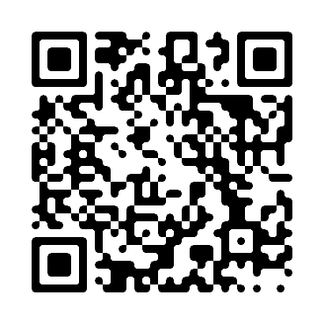
BREAKING DOWN BARRIERS
KU Amnesty Policy:
1. The University’s priority is your health. We want to remove barriers to reporting so students will get medical attention when it is needed. Neither the person needing medical attention, or the person/people/organization calling for help will be held accountable for the violations.
2. We may still have an educational conversation around substance use, but you will not have a disciplinary record.
3. This policy exists to protect our community, but it cannot be abused. Amnesty only applies on first time incidents. If someone is demonstrating a pattern of high-risk substance use, it will be addressed.
34
Source: Student Affairs Policy: http://policy.ku.edu/student-affairs/amnesty
Notes:
Timestamp: 64:00-66:00 minutes
As mentioned, one personal barrier is getting in trouble. Due to previous experiences, identity, and a multitude of other factors students may have difficulty trusting spaces that have historically been viewed as punitive. However, the University of Kansas is committed to promoting active bystander intervention. The University has enacted an amnesty policy to incentivize students to seek help for those in need of assistance. These things are not always the answer for everyone, but it’s important to know what resources are available. Here is the full policy: University of Kansas students seeking immediate medical assistance on behalf of persons experiencing drug- or alcohol-related emergencies will not be sanctioned for violations of University and/or Department of Student Housing drug- or alcohol-related policies. Additionally, the student(s) receiving medical assistance will not be sanctioned for violations of these policies following their first incident requiring medical attention. Repeat incidents of a student requiring medical assistance under this amnesty policy may be subject to disciplinary action under University and/or Student Housing policies. To that extent, the University of Kansas is committed in its efforts to remove barriers to the reporting process. The University recognizes that a complainant may be hesitant to report or witnesses may be hesitant to participate in the investigation process for fear of being held responsible for violations of the University’s Alcohol and Drug Policy. As such, parties making a report or participating in an investigation under the University’s Sexual Harassment Policy shall not be subjected to discipline under the Code of Student Rights and Responsibilities for personal consumption of alcohol and/or drugs. The Director of Student Conduct and Community Standards may at their discretion assign educational interventions when there is concern regarding the safety of a student in connection to the student’s alcohol or drug use. Source: http://policy.ku.edu/student-affairs/amnesty

Slide 36
WHO’S IN YOUR FLOCK?
Often, we can intervene more effectively when we work together.
Thinking about the people with whom you surround yourself, who can you turn to for help with a situation?
Are you that person for others?
How so?
35
Notes:
Timestamp: 66:00-67:00 minutes
The primary goal of this slide is to have participants discuss the individuals in their close circles that they can turn to for help. As we discussed in the last section, part of safely intervening is to intervene in a group. Ask the participants to discuss “who’s in their flock?”
The takeaway here is that intervention is best with a group. Working with our Flock is the best way to overcome these barriers.
Thinking about the people with whom you surround yourself, who can you can turn to for help with a situation?
Are you that person for others?
How so?
When intervening with a group, how can we take on specific tasks to overcome barriers that may exist based off our identity, relationship to the situation, etc.?

Slide 37
STEP THREE: INTERVENE with others and take action
36
Notes:
Timestamp: 67:00-67:30 minutes
The primary goal of this slide is to inform participants that active bystanders can, and often do, have a positive impact on the prevention of sexual violence and relationship violence.
Additional information on sexual assaults and on relationship violence: Third parties were present during 29% of incidents of sexual violence. Third parties helped in 35% of these acts of violence, made the situations worse in 12% of the cases, and did neither in 44%. In both cases, third parties were often more likely to help than hurt, but often did neither

Slide 38
STRATEGIES FOR INTERVENTION:
  DELEGATE
  DISTRACT
  DIRECT
  DOCUMENTATION+
Source: Vector Solutions
37
Notes:
Timestamp: 67:30-68:00 minutes
Once you have recognized a problem and identified the best way to intervene safely, it is time to strategize with others how to intervene. As you may recall from the required online training by Vector Solutions you completed prior to this session, there are four recommended strategies for intervention. They are:
Delegate
Distract
Direct
Documentation+
We will break down these strategies in the next few slides.

Slide 39
DELEGATE
Asking for help from another individual or individuals and developing a plan where some or all play a role in intervening.
This can include:
Find friends to intervene together.
Alert a friend of the potential victim and assist in intervening.
Seek someone you don’t know but who is authorized to represent others or address issues.
Source: Vector Solutions
38
Notes:
Timestamp: 68:00-69:30 minutes
Delegating is asking for help from another individual or individuals and developing a plan where some or all play a role in intervening.
This can include:
Find friends to intervene together.
Alert a friend of the potential victim and assist in intervening.
Seek someone you don’t know but who is authorized to represent others or address issues.
Delegation is taught during first aid and CPR training. The first thing people are taught to do when responding to an emergency is to delegate someone to call 9-1-1. You will notice that some people will freeze during an emergency, this is your opportunity to ask them for help and tell them what to do.

Slide 40
DISTRACT
Interrupting the situation without directly confronting the offender by creating a distraction.
This can include:
Establishing a relationship with someone
Making something up
Suggesting an alternate activity
Source: Vector Solutions
39
Notes:
Timestamp: 69:30-71:00 minutes
Distracting is interrupting the situation without directly confronting the offender by creating a distraction.
This can include:
Establishing a relationship with someone
Making something up
Suggesting an alternate activity
Many students do this already by choosing to go to the bathroom together to get away from people that are bothering them. Others will suggest grabbing Wheel Pizza or Fuzzy’s to make sure their group gets away from a potentially risky situation (and grab some delicious food after a long night out).

Slide 41
DIRECT
Talk to directly, in the moment, to prevent a problem situation from happening.
This can include:
Create a space or a timeout.
Check in regularly with potential victim or offender.
Give them different options to remove them from the situation.
Source: Vector Solutions
40
Notes:
Timestamp: 71:00-72:30 minutes
Direct
This approach refers to talking to directly, in the moment, to prevent a problem situation from happening. This can include:
Creating a space or timeout.
Check in regularly with potential victim or offender.
Give them different options to remove them from the situation.
Although this might seem like the ideal approach for some folks, it is important to remember that the direct approach is only successful if it leads to de-escalating the situation. A direct approach that escalates the situation could actually put the potential victim and yourself in harm’s way. Also, if you plan to be direct, consider talking through your approach with a friend so you know what you are going to say to the persons involved.
An Important Note
What works for you won’t work for everyone. If you’re someone who’s not confrontational, find someone else to help you, whether that is a friend or someone with more authority like KU Public Safety or an RA or Complex Director if you are in a residence hall. Please note that we do not in any way suggest physical violence as a means to intervene. In fact, the use of physical violence is a violation of KU’s Code of Student Rights and Responsibilities. The point is that these options provide a wide range of choices, which you can apply to most situations and can be individualized to fit your own level of comfort when it comes to intervening.

Slide 42
DOCUMENT
Record and/or take notes during an incident
This can include:
Video recording
Screenshots
Items to remember:
You should seek consent from the victim/survivor before you begin documenting.
Document is an and not an only.
Keep your attention on the person experiencing harm and make sure the documentation is focused on supporting them.
Source: Think About it online training: https://sapec.ku.edu/ThinkAboutIt
41
Notes:
Timestamp: 72:30-74:00 minutes
Documentation is in addition to the previous D’s. It is not intended to be completed as the only intervention strategy.
Documentation should be done with supporting the victim/survivor and not trying to cause retribution towards the perpetrator. If it safe to do so, folks should seek out consent before documentation especially if its form is taking videos of active events unfolding.

Slide 43
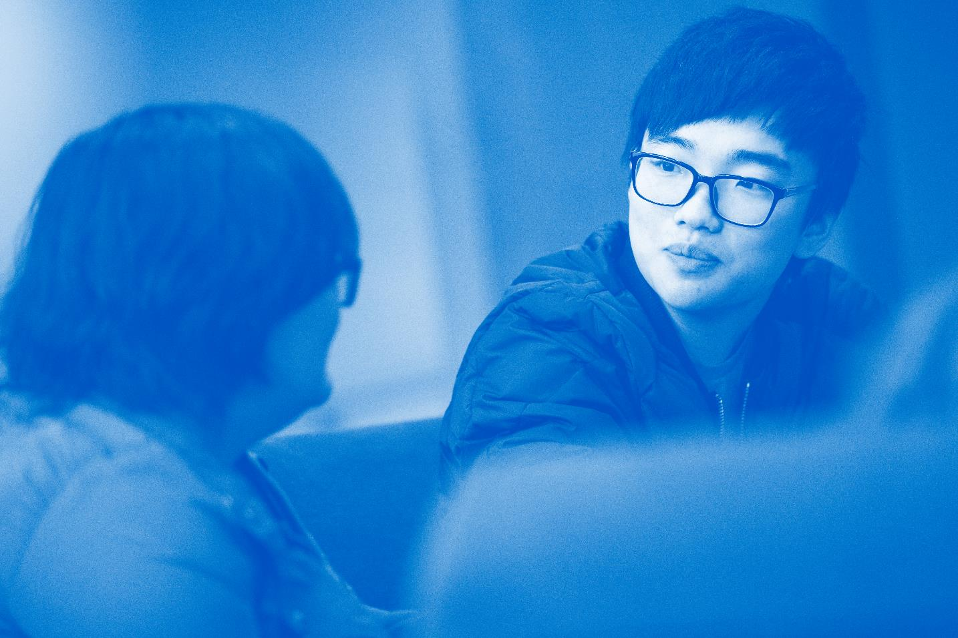
STEP FOUR: FOLLOW UP and determine what support and/
or accountability is needed
42
Notes:
Timestamp: 74:00-74:30 minutes
After intervening it is important to follow up with those involved. Sexual violence and attempted sexual violence can have serious negative consequences on the victim/survivor and those around them. Additionally, there may be an in stance where someone comes to you for support and you can be an active bystander in helping to
prevent secondary trauma. Over the next couple of slides we will provide you with some information on how to support survivors as well as how you can hold offenders accountable.

Slide 44
SUPPORTING SURVIVORS
Three things you should say to a survivor of sexual assault:
I believe you.
It’s not your fault.
How can I be helpful right now?
43
Notes:
Timestamp: 74:30-76:00 minutes
Knowing how to support survivors of sexual violence can seem challenging. Many people are fearful of saying the wrong thing. The best thing you can do is support that person. You are not expected to be a trained mental health professional to support survivors. Using affirming and supporting language is the most helpful way we can provide support. However, if you need some advice, here are three things we recommend you say to a survivor:
I believe you.
Believe them. This is the most important thing you can do. Even if the assault happened many years ago, they need to be believed now.
It’s not your fault.
Survivors of sexual assault/abuse and intimate partner violence tend to blame themselves for whatever happened to them. The assault or abuse is never the victim’s fault; it is the offender’s fault. So even if the survivor feels responsible, say clearly and compassionately, “It’s not your fault.”
How can I be helpful right now?
Offer practical support. Your friend may find that organizing her life is difficult while she is in crisis. You can help by offering to help. For instance, they may need help moving out of their apartment or they may be nervous about attending their first counseling session. Just by offering your help, they will know that you care and if they need you, they'll be able take you up on it.
Do Not.
Tell them what to do. You may offer them options but you need to make them feel empowered and in control.

Slide 45
CAMPUS AND COMMUNITY RESOURCES
Free Late-Night Rides Home:
KU SafeRide
Download the ‘KU SafeRide’ App
TAKE A PIC OF THIS SLIDE!
Confidential Support:
KU Care Services
785-864-9255 • careservices.ku.edu
KU Counseling and Psychological Services (CAPS)
785-864-2277 • caps.ku.edu
The Sexual Trauma & Abuse Care Center
785-843-8985 (24/7) • stacarecenter.org
Reporting:
Office of Civil Rights & Title IX
785-864-6414 • civilrights.ku.edu
KU Report It
785-864-3710 • reportit.ku.edu
44
Notes:
Timestamp: 76:00-77:00 minutes
The University provides support for survivors of sexual violence including our CARE Coordinator. The CARE Coordinator can provide survivors with support and resources in a confidential setting. Survivors wishing to seek support off campus are encouraged to utilize the Sexual Trauma and Abuse Care Center. The Care Center offers free confidential support 24 hours a day/7 days a week.
Any student can report violations of the University’s policies on sexual violence to the Office of Civil Rights & Title XI. Even if a student does not wish to file a report, they may reach out to Title XI to learn about resources and support available to students.
Crisis services are now free through CAPS.

Slide 46
GROUP QUESTIONS
What issue or issues do you RECOGNIZE in this situation?
What barriers can you IDENTIFY and how can you safely intervene with others?
How would you and your group members INTERVENE in this situation? (Hint: Delegate, Distract, or Direct, and Document)
How would you FOLLOW-UP with both individuals involved?
45
Notes:
Timestamp: 77:00-78:00 minutes
We have created 4 scenarios. Two of them are focused on digital interactions. We believe using 1 of those is important to discuss. The other 2 are focused on in person interactions. Choose a minimum of 2 scenarios to do with the group. If you are doing good on time you can try to do more.
Have the participants break up into groups of 5-6.
Give the participants copies of the scenarios. Have them read the scenario aloud and then answer the questions as a small group.
Inform students that they can come up with their own suggestions. Encourage them to be creative!
Ask participants to work in small groups. One group will work on one of the other scenarios so they may gain skills in the decision process and to expand their repertoire of helping behaviors.
Go over each of the scenarios, facilitating a conversation that focuses on their thought process. Challenge them with follow-up questions that require them to understand how different contexts can change their intervention strategy.
If groups are struggling on Follow-Up, remind that that following up with the person who caused the harm/crossed the boundaries can be really impactful.
Questions for all groups to discuss:
What issue or issues do you RECOGNIZE in this situation?
What barriers can you IDENTIFY and how can you safely intervene with others?
How would you and your group members INTERVENE in this situation? (Hint: Delegate, Distract, or Direct, and Document)
How would you FOLLOW-UP with both individuals involved?

Slide 47
4 D’s of Intervention
Delegate
Asking for help from another individual or individuals and developing a plan where some or all play a role in intervening.
Distract
Interrupting the situation without directly confronting the offender by creating a distraction.
Direct
Talk to directly, in the moment, to prevent a problem situation from happening.
Document
Record and/or take notes during an incident
46
Notes:
Timestamp: 78:00-83:00 minutes
Once students have broken into their groups you can put this slide up so they can use it as a reference while they work through their scenario.

Slide 48
GROUP DEBRIEF
What issue or issues do you RECOGNIZE in this situation?
What barriers can you IDENTIFY and how can you safely intervene with others?
How would you and your group members INTERVENE in this situation? (Hint: Delegate, Distract, or Direct, and Document)
How would you FOLLOW-UP with both individuals involved?
47
Notes:
Timestamp: 83:00-90:00 minutes
We have created 4 scenarios. Two of them are focused on digital interactions. We believe using 1 of those is important to discuss. The other 2 are focused on in person interactions. Choose a minimum of 2 scenarios to do with the group. If you are doing good on time you can try to do more.
Have the participants break up into groups of 5-6.
Give the participants copies of the scenarios. Have them read the scenario aloud and then answer the questions as a small group.
Inform students that they can come up with their own suggestions. Encourage them to be creative!
Ask participants to work in small groups. One group will work on one of the other scenarios so they may gain skills in the decision process and to expand their repertoire of helping behaviors.
Go over each of the scenarios, facilitating a conversation that focuses on their thought process. Challenge them with follow-up questions that require them to understand how different contexts can change their intervention strategy.
If groups are struggling on Follow-Up, remind that that following up with the person who caused the harm/crossed the boundaries can be really impactful.
Questions for all groups to discuss:
What issue or issues do you RECOGNIZE in this situation?
What barriers can you IDENTIFY and how can you safely intervene with others?
How would you and your group members INTERVENE in this situation? (Hint: Delegate, Distract, or Direct, and Document)
How would you FOLLOW-UP with both individuals involved?

Slide 49
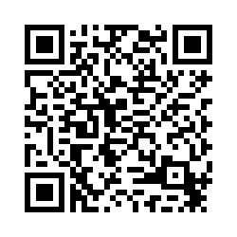


BEFORE YOU LEAVE...
Scan the QR Code and take the Assessment of Learning
This survey will help inform changes and improvements to Jayhawks Give a Flock in the future.
48
Notes:
Until they are completed with the survey.

Slide 50



